Slide 1

Fundamentals of Computer vision
A Seminar on
Presented By:-
Pradeep anand (2004091)
Anurag Singh (2004102)
Ayush Gupta (2004106)
ECE Department
NIT Patna
Session – 2023-24

Slide 2


Contents
Introduction
Why computer vision?
Some Real-World Applications
How does CV Work?
Research Areas (Future Scope)
Challenges
Conclusion
References

Slide 3
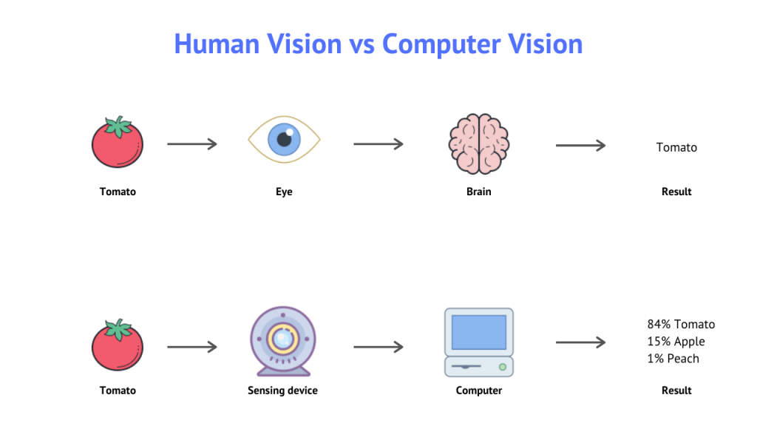
Introduction
Ever wondered how we humans see and interpret our world
Computer Vision is field of Computer Science and subfield of AI that enables Computers/ systems to see, process, identify images/videos or other visual inputs and take some actions/decisions based on that information, much like the human vision system.
Human Vision vs Computer Vision [1]

Slide 4
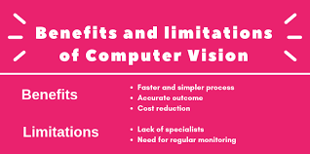
Why computer vision?
Computer Vision is not just a fascinating field of study. It is a transformative technology.
Automating tasks
Increases Efficiency
Reduces costs
Protection/Safety
Benefits and Limitations of Computer Vision [2]

Slide 5
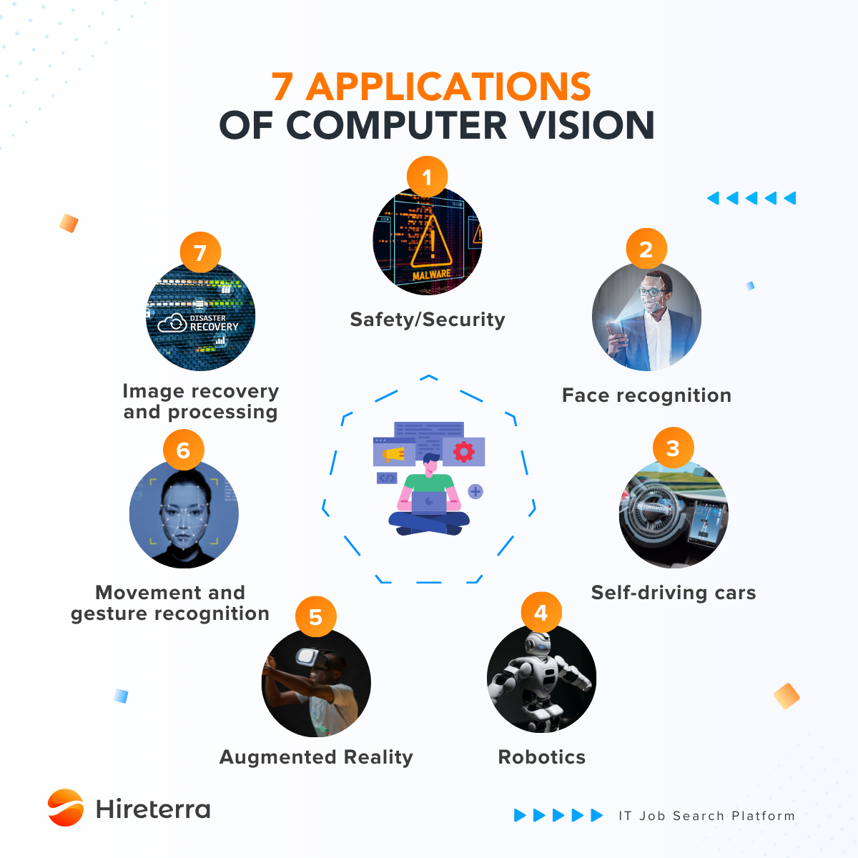
Real-World Applications
AR/VR
Human-Computer Interactions – movement/gesture recognition
Face recognition and Object detection
3D Movies/ Video Games – merging CGI with live actors
Fingerprint recognition/ Biometrics
Optical Character Recognition (OCR)
Surveillance
Retail automation (Personalized Search) – Amazon/Flipkart etc.
Medical Imaging
Applications of Computer Vision [3]

Slide 6
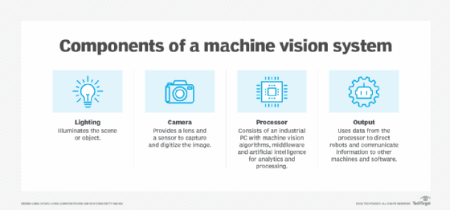
How does Computer Vision work?
Computer Vision involves 3 fundamental steps with their components:-
Image Acquisition – Camera sensors
Image Processing – Image Processor (CPU)
Decision/Interpretation by AI model – Trained ML Algorithms, Computer Neural Network (CNN)
Components of Computer Vision System [4]

Slide 7
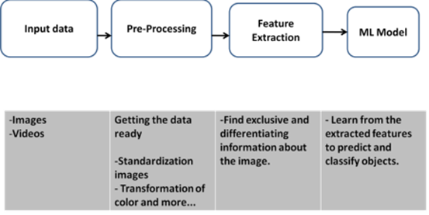
How does Computer Vision work?
Steps involved in the Working of Computer Vision [5]

Slide 8
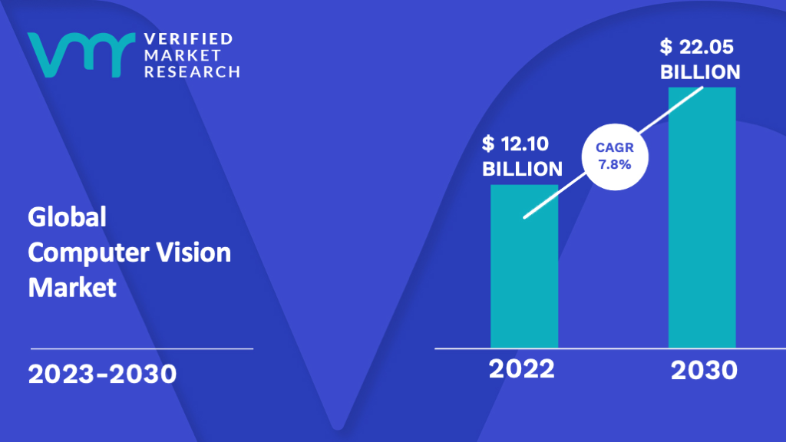
Research Areas (Future Scope)
Robotic Vision
Activity Analysis
Facial Expression/Emotions Detection
Handwriting Detection
Metaverse
Generative AI (Dall-E and Lensa AI)
Merge Reality (MR)
Global Computer Vision Market (Research) [6]

Slide 9
Challenges
Accuracy – due to improper lighting, poor image/video quality, occlusion
Privacy concerns
Lack of trained data and models
Huge time and heavy system requirements to train models
Regular Supervision needed - Needs team of experts in AI & ML to operate systems properly and regularly.

Slide 10
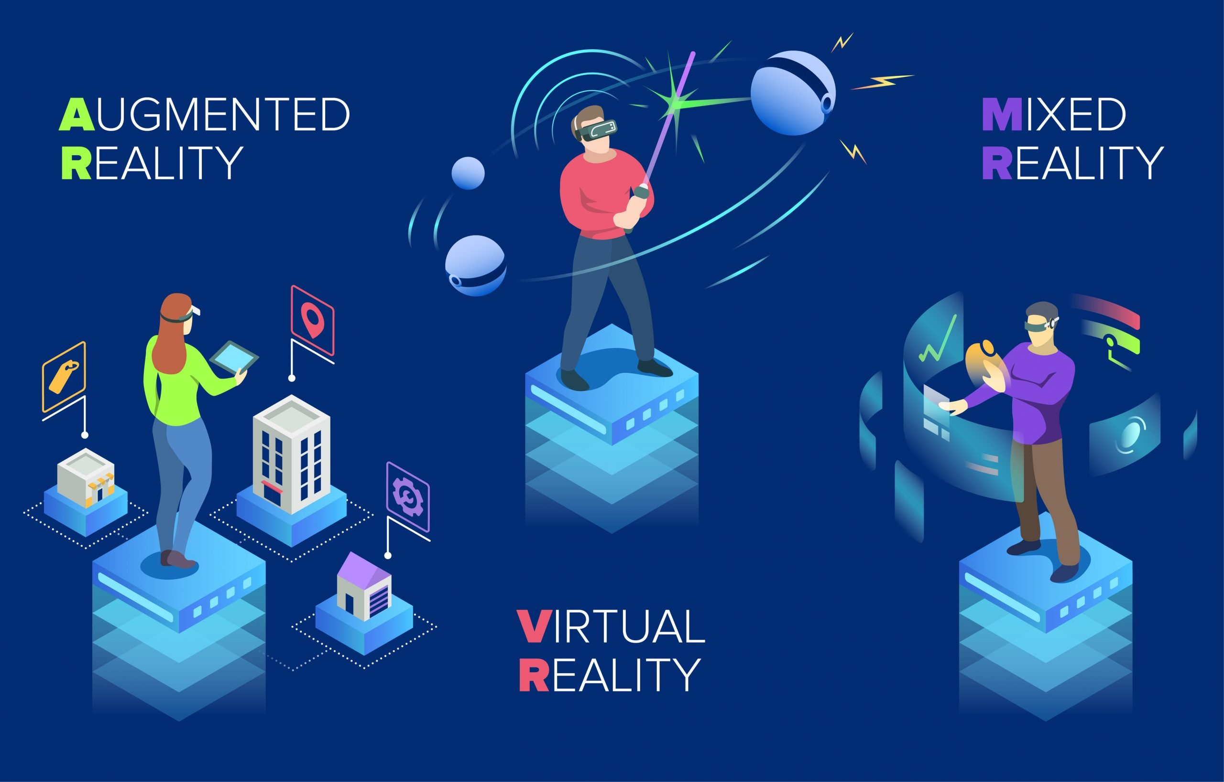
Conclusion
Computer Vision is an interesting domain in Computer Science and AI/ML.
Enables computer/systems to see just like we humans see and understand our world.
Many real-life applications uses Computer Vision to automate tasks for less human effort and increase efficiency.
Many research works are going on. Going to acquire BIG Market share by 2030. It has excellent scopes in future.
AR, VR & MR [7]

Slide 11
References
https://kajabi-storefronts-production.kajabi-cdn.com/kajabi-storefronts-production/file-uploads/blogs/22606/images/b4c5207-412b-f32-df32-33ece5ebcbbd_Human-Vision-vs-Computer-vision-1024x576.png
https://www.allerin.com/wp-blog/wp-content/uploads/2019/06/Understanding-computer-vision-its-advantages-and-limitations.png
https://miro.medium.com/v2/resize:fit:720/format:webp/1*nxHCgMmS0o-I7377WAwWPA.png
https://cdn.ttgtmedia.com/rms/onlineimages/components_of_a_machine_vision_system-f.png
https://freecontent.manning.com/wp-content/uploads/Elgendy_tCVPp1_02.png
https://www.verifiedmarketresearch.com/wp-content/uploads/2021/10/Computer-Vision-Market-is-estimated-to-grow-at-a-CAGR-of-7.8-reach-US-22.05-Bn-by-the-end-of-2030.png
https://qph.cf2.quoracdn.net/main-qimg-2c5652ed2440868cd71df6a38df393ba
https://homepages.inf.ed.ac.uk/rbf/BOOKS/BANDB/Ballard__D._and_Brown__C._M.__1982__Computer_Vision.pdf
https://www.geeksforgeeks.org/computer-vision/?ref=lbp

Slide 12
Thank you!

